Slide 1
Los Inventos Tecnólogicos en España y Hispanoamérica
Connor Guarino

Slide 2
Introducción
What do an ink pen and a spacesuit have in common?
They’re all inventions from Spanish speaking countries!
Not only that, but they are inventions that changed the course of human history.

Slide 3


Agenda
A
Introducción
El Bolígrafo
El Traje de Astronauta
Revistar

Slide 4
El Bolígrafo
The Ballpoint Pen

Slide 5
El Bolígrafo
B
Who and When?
In 1938, a Hungarian man living in Argentina named László Bíró filed a patent for the first modern ballpoint pen with the help of his brother György.
Why?
László worked as a newspaper editor and was constantly combating the ink drying on his fountain pens.
How?
To develop what we now know as the ballpoint pen, László started with the design of man named John J. Loud.
Loud had created and briefly held a patent for the ‘first’ ballpoint pen, but it was a tool intended for writing on leather and his patent elapsed because it didn’t survive in the market.

Slide 6
What’s so tough about making a pen?
The biggest challenge in designing the ballpoint pen had very little to do with the pen itself, it was the ink.
At the time, ink was made with water and kept in inkwells. This type of ink dried quickly and storing a meaningful amount inside a pen was difficult as it was much thinner.
The biggest innovation László made was not actually the pen, but a paste-based ink!
Ink made from paste took longer to dry and due to its viscosity, was much easier to store within the frame of the pen.

Slide 7
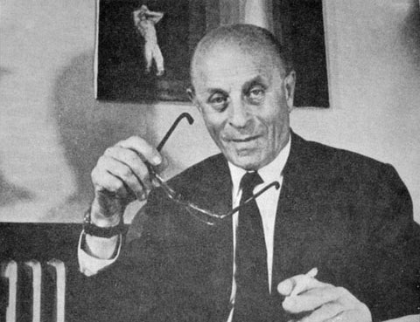
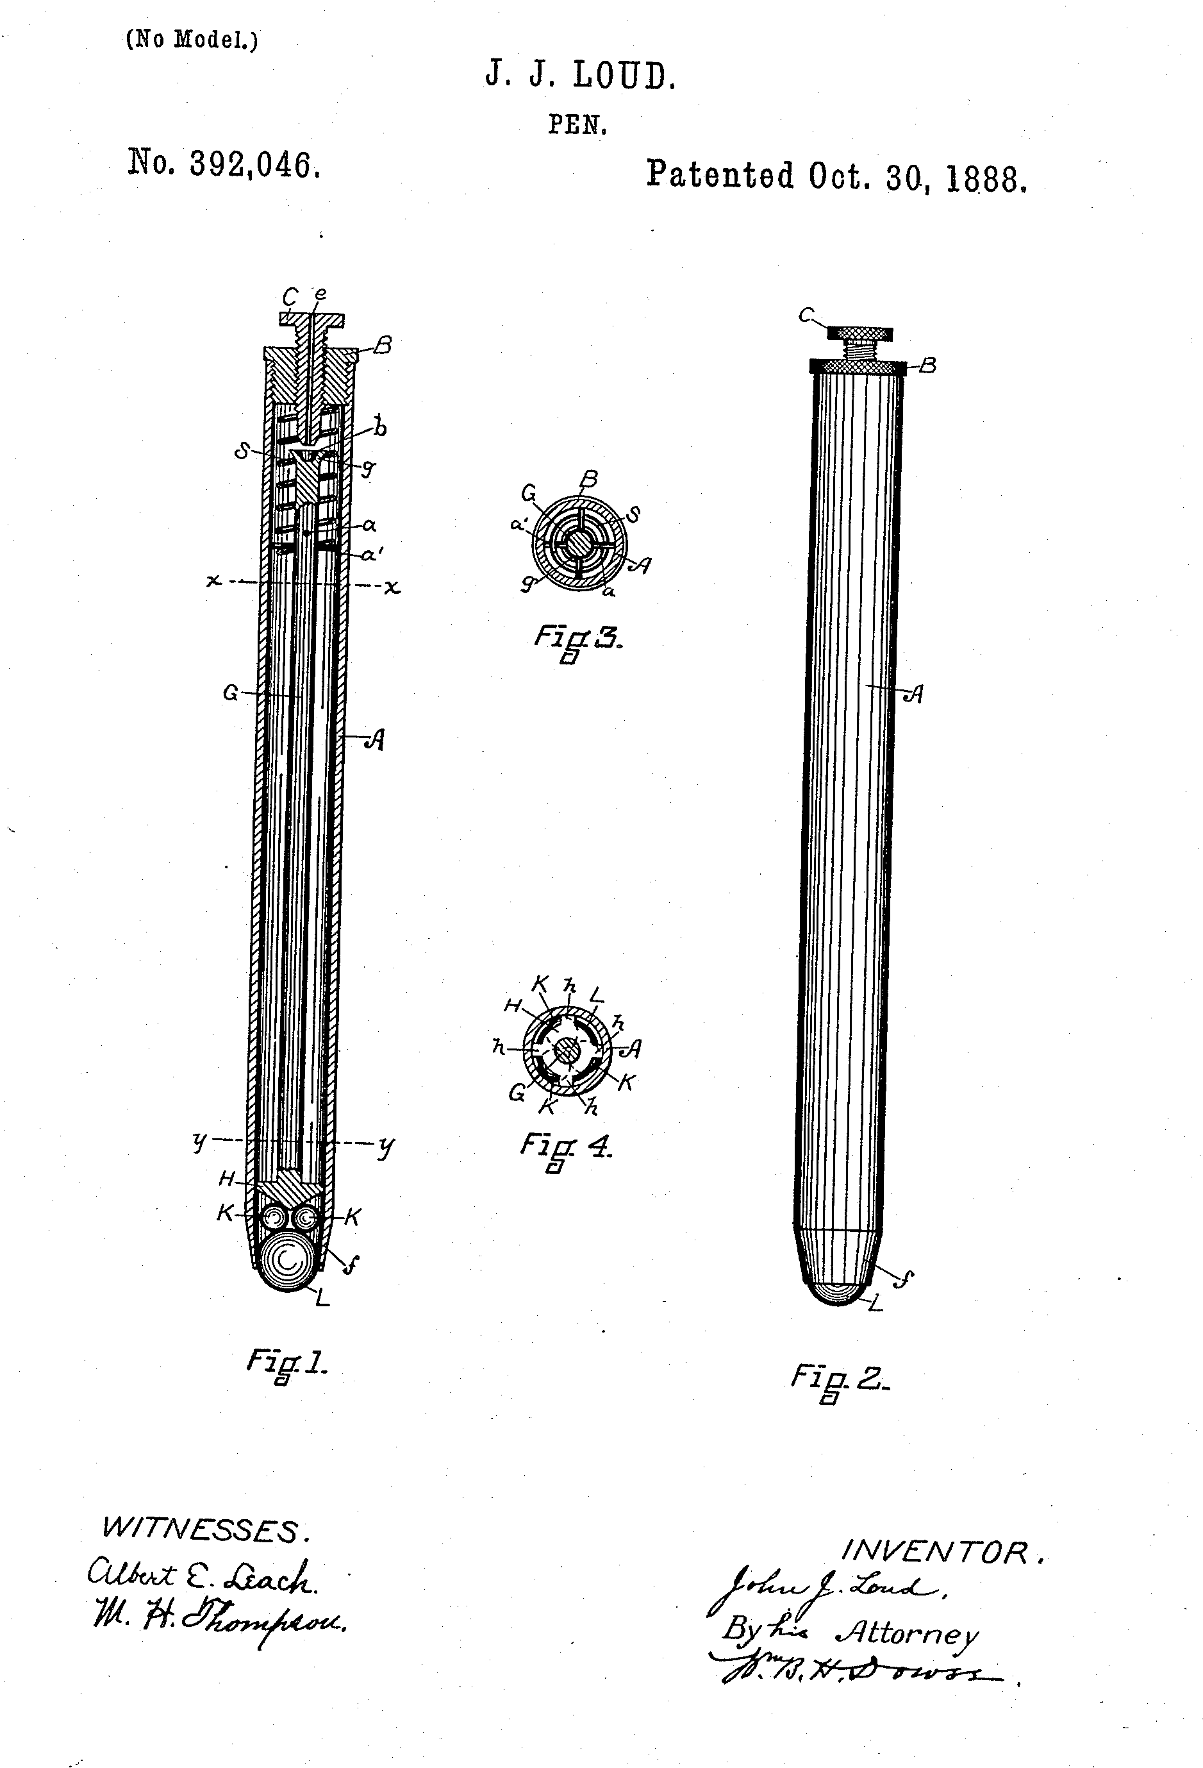
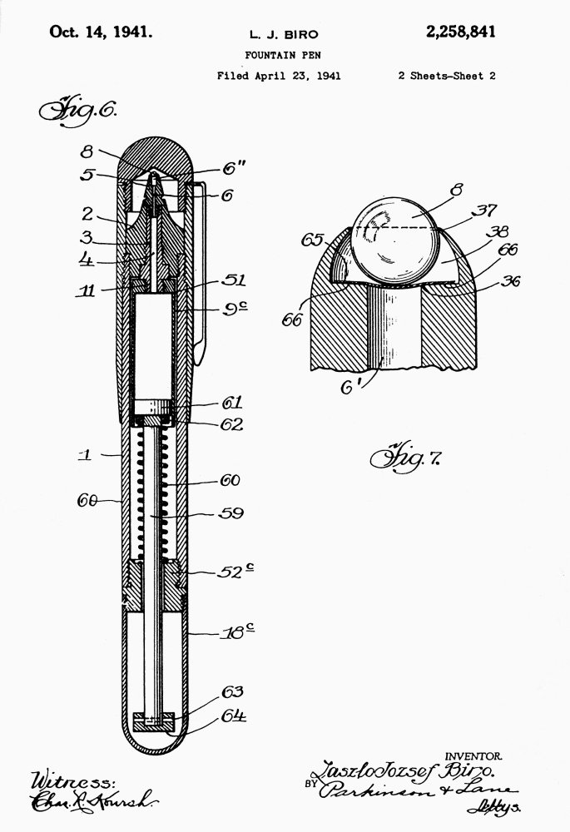
Pictured Left: Loud’s Original Patent
Pictured Right: Bíró’s Patent
- Photo Credited to U.S. Patent Office
Pictured Above: László Bíró
- Photo Credited to Dayspring Pens

Slide 8
Certainly, when I was a kid, I wanted to wear a spacesuit.
“
”
Former Astronaut, Julie Payette

Slide 9
El Traje de Astronauta
S
Who and When?
Surprisingly, what we refer to as the first ‘spacesuit’ was made in 1928 by Emilio Herrera.
Why?
Herrera was an engineer in the Spanish military and worked specifically with hot-air balloons. After the war, he made it a goal to successfully and safely reach the stratosphere. Prior to Herrera, an attempt was made by Spanish aeronauts but resulted in the death of the crew due to asphyxiation.
How?
The four threats at high altitude are hypothermia, depressurization or the “bends”, asphyxiation, and radiation. To defend against these, Herrera constructed a suit that incorporated multiple special-purpose layers: wool for insulation, rubber for pressure, steel enforced fabric for durability, silver for heat dissipation, and finally aluminum and glass for radiation

Slide 10
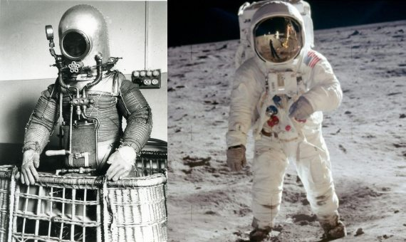
Pictured Left: Herrera’s Spacesuit
Pictured Right: Modern Spacesuit
- Photo Credited to Wikimedia Commons

Slide 11
Gracias por su Atención!

Slide 12
Revistar
True or False:
László Bíró is credited with the design of the very first ballpoint pen.
The first spacesuit used a ceramic layer to absorb heat, similar to modern spaceships.
Ballpoint pens were created to replace quills as a writing utensil.

Slide 13
Revistar
Multiple Choice:
Which of these is NOT a danger when attempting to enter the stratosphere?
Radiation
Hypothermia
Avian Impact

Slide 14
Revistar
Multiple Choice:
What material was Loud’s pen meant to write on?
Canvas
Leather
A11 Letter Paper

Slide 15
Revistar
Multiple Choice:
What unit did Herrera work in during his time as a soldier?
Land, Air, and Sea Division
Hot-Air Balloon
Infantry

Slide 16
Revistar
Extended Response:
Do you think the ballpoint pen or the spacesuit has had a bigger impact on human history? Why do you think that?

